Slide 1
Software Engineering Lab
Building a blog web application
Lakehead university
Department of Computer Science
COMP-3415 - Software Engineering
Presented by: Gad Gad

Slide 2
Outline
Introduction
Project layout
Front end
Back end
Demo

Slide 3
Introduction
Flask is a Python web framework that simplifies the process of building web applications.
We will focus on how Flask can be used to create a blogging web application, called Flaskr, covering both the front-end and back-end features.
The user interface is built using HTML and CSS, while Flask is used to organize the front-end and provide built-in features for back-end development.
These features include a database for users and content and user authentication.
Languages and Tools:
Front end
HTML
CSS
Back end
Flask: web dev
SQLite: Database
Werkzeug: Security

Slide 4
Project Layout
├── flaskr/
│ ├── __init__.py
│ ├── db.py
│ ├── schema.sql
│ ├── auth.py
│ ├── blog.py
│ ├── templates/
│ │ ├── base.html
│ │ ├── auth/
│ │ │ ├── login.html
│ │ │ └── register.html
│ │ └── blog/
│ │ ├── create.html
│ │ ├── index.html
│ │ └── update.html
│ └── static/
│ └── style.css
Root Dir
Flask is a flexible web application building framework.
It does not require a specific project structure.
However, this project uses a common Flask structure that’s easy to expand on.
Back end
Front end

Slide 5
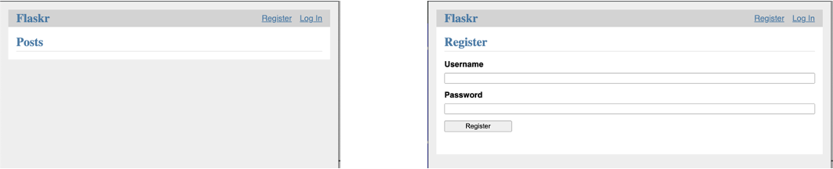
Front end of Flaskr - HTML and CSS
Front-end includes multiple HTML files, each associated with a Flask route function
HTML files stored in templates folder inside flaskr application folder
base.html used as template to render pages with similar theme
Flask automatically serves static files relative to flaskr/static directory
Add CSS file to base.html template using url_for('static', filename='style.css')
Other static files like JavaScript functions or images can also be placed under flaskr/static directory

Slide 6
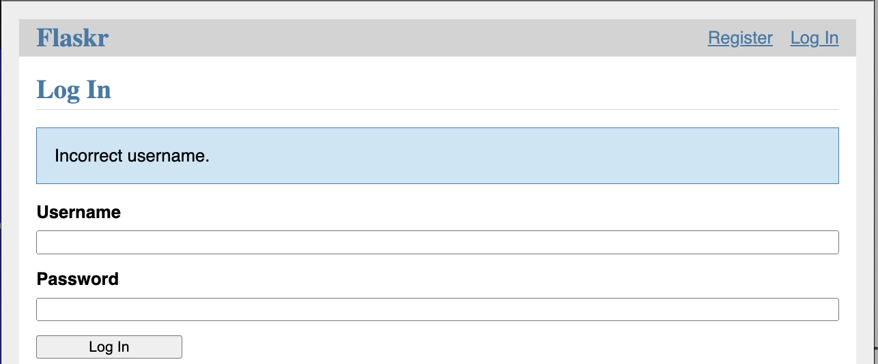
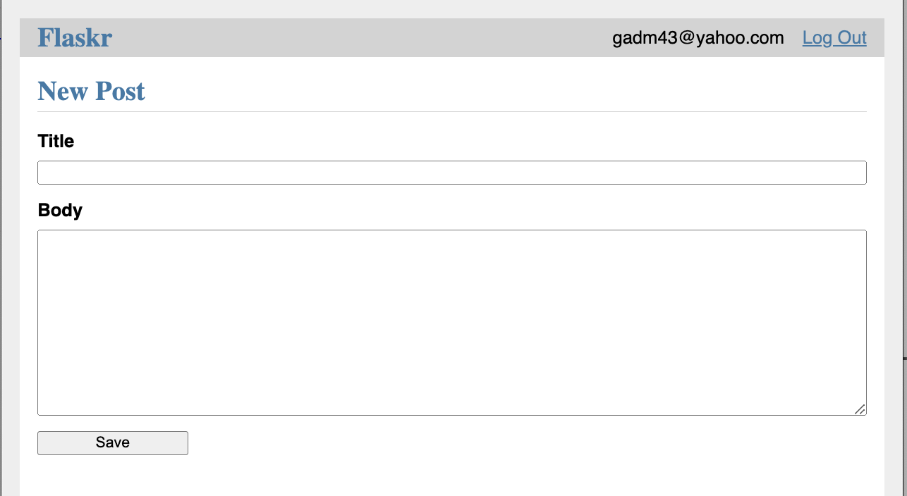
Front end - Jinja engine
Flask uses Jinja to embed and render Python-like code in HTML
Jinja code makes it easy to create different views from a base HTML file
Note: Jinja is a templating engine for Python and used by Flask to render templates.
<link rel="stylesheet" href="{{ url_for('static', filename='style.css') }}">
<nav>
<h1><a href="{{ url_for('index') }}">Flaskr</a></h1>
<ul>
{% if g.user %}
<li><span>{{ g.user['username'] }}</span>
<li><a href="{{ url_for('auth.logout') }}">Log Out</a>
{% else %}
<li><a href="{{ url_for('auth.register') }}">Register</a>
<li><a href="{{ url_for('auth.login') }}">Log In</a>
{% endif %}
</ul>
</nav>

Slide 7
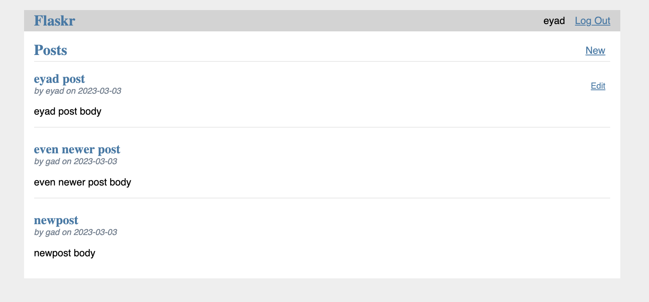
Front end - Jinja example
Flask uses Jinja to produce different views by introducing logic to HTML code.
{% block content %}
{% for post in posts %}
<article class="post">
<header>
<div>
<h1>{{ post['title'] }}</h1>
<div class="about">by {{ post['username'] }} on {{ post['created'].strftime('%Y-%m-%d') }}</div>
</div>
{% if g.user['id'] == post['author_id'] %}
<a class="action" href="{{ url_for('blog.update', id=post['id']) }}">Edit</a>
{% endif %}

Slide 8
Back end - Factory function
The factory function is one of Flask design patterns to create a Flask web application.
The __init__.py file serves to tell python that flaskr is a package, and the create_function inside it is a Flask factory function that:
1- Creates a Flask application that can be run using flask command
2- Registers blueprints
3- Configures the SQL database
def create_app(test_config=None):
app = Flask(__name__, instance_relative_config=True)
app.config.from_mapping(
DATABASE=os.path.join(app.instance_path, "flaskr.sqlite"))
db.init_app(app)
app.register_blueprint(auth.bp)
app.register_blueprint(blog.bp)
return app

Slide 9
Back end - Blueprints and views
Our Flask blog app will have two blueprints:
auth, for authentication functions
blog, for blog functions.
A blueprint is similar to an application. It has a name, groups related views, and its name is prepended to its associated routes making it easier to deal with and expand on.
Create a Blueprint for auth
bp = Blueprint('auth', __name__, url_prefix='/auth')
Register the Blueprint to the app
def create_app():
app = ...
# existing code omitted
from . import auth
app.register_blueprint(auth.bp)
return app
Flaskr
auth
blog
auth/register
blog/create
Use the Blueprint
auth/login
blog/update
@bp.route("/<int:id>/delete", methods=("POST",))
@login_required
def delete(id):
blog/delete

Slide 10
Back end - Database
The application uses an embedded SQLite database
To access a database, you have to first connect to it. This connection is usually related to a request.
Database schema
CREATE TABLE user (
id INTEGER PRIMARY KEY AUTOINCREMENT,
username TEXT UNIQUE NOT NULL,
password TEXT NOT NULL
);
CREATE TABLE post (
id INTEGER PRIMARY KEY AUTOINCREMENT,
author_id INTEGER NOT NULL,
created TIMESTAMP NOT NULL DEFAULT CURRENT_TIMESTAMP,
title TEXT NOT NULL,
body TEXT NOT NULL,
FOREIGN KEY (author_id) REFERENCES user (id)
);
Initialize the database
def init_db():
"""Clear existing data and create new tables."""
db = get_db()
with current_app.open_resource("schema.sql") as f:
db.executescript(f.read().decode("utf8"))

Slide 11
Back end - Authentication - Storing users credentials in cookies
session variable is a dict that stores data across requests. When validation succeeds, the user’s id is stored in a new session. The data is stored in a cookie that is sent to the browser, and the browser then sends it back with subsequent requests. Flask securely signs the data so that it can’t be tampered with.
@bp.before_app_request
def load_logged_in_user():
"""If a user id is stored in the session, load the user object from
the database into ``g.user``."""
user_id = session.get("user_id")
if user_id is None:
g.user = None
else:
g.user = (
get_db().execute("SELECT * FROM user WHERE id = ?", (user_id,)).fetchone()
)
Built-in blueprint-based decorator
Before serving any request, do that following:, copy user_id from session to g

Slide 12
Back end - Authentication - Requiring user authentication for a function
Create a decorator
Redirects user to login view for certain requests that require authentication
Using the @login_required decorator to create a new post.
def login_required(view):
"""View decorator that redirects anonymous users to the login page."""
@functools.wraps(view)
def wrapped_view(**kwargs):
if g.user is None:
return redirect(url_for("auth.login"))
return view(**kwargs)
return wrapped_view
@bp.route("/create", methods=("GET", "POST"))
@login_required
def create():

Slide 13
DEMO
Code available at https://github.com/gadm21/Flask-Blog-application

